Slide 1
LIONS ORIENTATION
April 2013
PDG/PCC Rod Wright

Slide 2
Member Orientation
Member orientation is broken out into five sections:
Who Lions Are
Your Club
District
Multiple District
Lions Clubs International (LCI)
Notes:
First Lions Club outside of the United States – Windsor, Ontario, Canada

Slide 3
Who Lions Are
Lions are men and women dedicated to serving those in need, whether in their own community or around the world.
Nearly 1.4 million members
Over 200 countries
More than 46,000 clubs
Notes:
First Lions Club outside of the United States – Windsor, Ontario, Canada

Slide 4
What is the official name?

Slide 5
What is the official name?
The International Association of Lions Clubs
Or
Lions Clubs International

Slide 6
Vision Statement
To be the global leader
in community
and humanitarian service.

Slide 7
Mission Statement

Slide 8
Mission Statement
To empower volunteers

Slide 9
Mission Statement
To empower volunteers
to serve their communities,
meet humanitarian needs,

Slide 10
Mission Statement
To empower volunteers
to serve their communities,
meet humanitarian needs,
encourage peace

Slide 11
Mission Statement
To empower volunteers
to serve their communities,
meet humanitarian needs,
encourage peace
and promote
international understanding
through Lions Clubs.

Slide 12
Lions Motto:
“We Serve”

Slide 13
Lions Code of Ethics
TO SHOW my faith in the worthiness of my vocation by industrious application to the end that I may merit a reputation for quality of service.
TO SEEK success and to demand all fair remuneration or profit as my just due, but to accept no profit or success at the price of my own self-respect lost because of unfair advantage taken or because of questionable acts on my part.
TO REMEMBER that in building up my business it is not necessary to tear down another’s; to be loyal to my clients or customers and true to myself.
WHENEVER a doubt arises as to the right or ethics of my position or action toward others, to resolve such doubt against myself.

Slide 14
Lions Code of Ethics
TO HOLD friendship as an end and not a means. To hold that true friendship exists not on account of the service performed by one to another, but that true friendship demands nothing but accepts service in the spirit in which it is given.
ALWAYS bear in mind my obligations as a citizen to my nation, my province and my community, and to give them my unswerving loyalty in work, act and deed. To give them freely of my time, labour and means.
TO AID others by giving my sympathy to those in distress, my aid to the week, and my substance to the needy.
TO BE CAREFUL with my criticism and liberal with my praise; to build up and not destroy.

Slide 15
Lions Clubs International Purpose
TO CREATE and foster a spirit of understanding among the peoples of the world.
TO PROMOTE the principles of good government and good citizenship.
TO TAKE an active interest in the civic, cultural, social and moral welfare of the community.
TO UNITE the clubs in the bonds of friendship, good fellowship and mutual understanding.
TO PROVIDE a forum for the open discussion of all matters of public interest; provided, however that partisan politics and sectarian religion not be debated by club members
TO ENCOURAGE service-minded people to serve their community without personal financial reward, and to encourage efficiency and promote high ethical standards in commerce, industry, professions, public works and private endeavors.

Slide 16
Slogan:
L
I
O
N
S

Slide 17
Slogan:
Liberty
I
O
N
S

Slide 18
Slogan:
Liberty
Intelligence
O
N
S

Slide 19
Slogan:
Liberty
Intelligence
Our
N
S

Slide 20
Slogan:
Liberty
Intelligence
Our
Nations
S

Slide 21
Slogan:
Liberty
Intelligence
Our
Nations
Safety

Slide 22
Slogan:
Liberty
Intelligence
Our
Nations
Safety

Slide 23
Official Colors:
Purple/Blue – represents loyalty to country, friends and self – the integrity of mind and heart – it is the color of strength, courage and dedication.

Slide 24
Official Colors:
Gold – symbolizes sincerity and purpose, liberality in judgement, purity in life and generosity in mind, heart and commitment to mankind.

Slide 25
Official Emblem:
The current emblem was adopted at the International Convention in 1919.
The LIONS facing in opposite direction depict the past representing the “pride of our heritage” and the “confidence of our future”.

Slide 26
International Fellowship & Understanding:
Language is not a barrier as international fellowship and understanding is a matter of spirit, communicating with one another through club activities and world service projects.

Slide 27
LIONS HISTORY TIMELINE
1917 Founded on June 7, by businessman Melvin Jones
1920 First Lions Club outside the United States
1925 Helen Keller challenged the LIONS to become “Knights of the Blind”
1945 Lions Clubs International helps form the Non-Govern- mental Organizations section of the United Nations
1968 Lions Clubs International Foundation established
1987 Lions Clubs International becomes the first service organization to admit women as members
1988 Lions International Peace Poster Contest is introduced
1989 First Lions Club organized in “Eastern Bloc” countries
1990 SightFirst initiative is launched
2002 Lions Clubs chartered in China
Notes:
First Lions Club outside of the United States – Windsor, Ontario, Canada

Slide 28
QUIZ:
Which club is the oldest Lions Club in District N-1?

Slide 29
QUIZ:
Which club is the oldest Lions Club in District N-1?
Fort Fairfield Lions Club, Fort Fairfield, Maine, USA chartered on July 27, 1937.

Slide 30
QUIZ:
Which club is the oldest Canadian Lions Club in District N-1?

Slide 31
QUIZ:
Which club is the oldest Canadian Lions Club in District N-1?
Moncton Lions Club, Moncton, New Brunswick chartered on April 6, 1949.

Slide 32
International Conventions
First International Convention, Dallas Texas
Helen Keller address the LIONS at Cedar Point, Ohio challenging them to become “knights of the blind in the crusade against darkness”
2014 Toronto, Canada

Slide 33
Your LIONS Club
Membership Categories
Active
Member-at-Large
Honorary
Privileged
Life Member
Associate Member
Affiliate Member

Slide 34
Your LIONS Club
Membership Categories
Active
Member-at-Large
Honorary
Privileged
Life Member
Associate Member
Affiliate Member
Notes:
Active
Entitled to all rights and privileges
Regular attendance
Club, District, International dues
Participate in Club activities
Conduct reflecting favorable image
Voting privileges
Eligibility to seek Club, District or International office
Delegate to District, Multiple or International Convention

Slide 35
Your LIONS Club
Membership Categories
Active
Member-at-Large
Honorary
Privileged
Life Member
Associate Member
Affiliate Member
Notes:
A member who has moved or because of health or other legitimate reason is unable to attend club meetings
Must be approved by the board of directors.
Reviewed every 6 months
Must pay dues (Club, District & Int’l)
Vote in Club matters ONLY
Can not hold office or be a delegate
Doesn’t have to attend meetings

Slide 36
Your LIONS Club
Membership Categories
Active
Member-at-Large
Honorary
Privileged
Life Member
Associate Member
Affiliate Member
Notes:
Honorary
Bestowed by a Lions Club
Club pays all fees and dues to District & International
Not required to attend meetings or activities
Can not hold office or be a delegate.

Slide 37
Your LIONS Club
Membership Categories
Active
Member-at-Large
Honorary
Privileged
Life Member
Associate Member
Affiliate Member
Notes:
Privileged
Been a Lion for 15+ years
Can not attend meetings due to illness, advanced age, or other legitimate reason
Pay dues (local, district, Int’l)
Right to vote
Can not hold office

Slide 38
Your LIONS Club
Membership Categories
Active
Member-at-Large
Honorary
Privileged
Life Member
Associate Member
Affiliate Member
Notes:
Life Member
Lion for 20+ years (15 years and 70 years of age)
Active membership with outstanding service
Recommended by their club
Payment of $500 US to LCI
Approved by the International Board of Directors
Club pays International dues
Individual pays Club & District dues
Can vote, hold office and be delegate
Does not have to attend meetings

Slide 39
Your LIONS Club
Membership Categories
Active
Member-at-Large
Honorary
Privileged
Life Member
Associate Member
Affiliate Member
Notes:
Associate
Holds a membership in another Lions Club
Reviewed annually
Not reported to LCI on M&A
May vote on club matters
Can not be a delegate at any level on behalf of Associate member club
Can not hold office in Club
May be assessed local club dues
No attendance requirement

Slide 40
Your LIONS Club
Membership Categories
Active
Member-at-Large
Honorary
Privileged
Life Member
Associate Member
Affiliate Member
Notes:
Affiliate
Community member who is unable to participate as an Active member
Conferred by the Club Board of Directors
Can vote on Club matters only
Can not be a delegate
Can not hold office
Must pay club, district and Int’l dues
No attendance requirement

Slide 41
Your LIONS Club
Club Budgets
Activities – funds raised from the public through projects can only be used for community/public need.
Administration – finances club operations, comes mostly from club dues.

Slide 42
Your LIONS Club
Officers and Board of Directors
Officers are elected annually.
Directors are elected for two year terms.

Slide 43
Your LIONS Club
Officers and Board of Directors
President
Immediate Past President
Vice Presidents
Secretary
Treasurer
Lion Tamer
Tail Twister
Membership Director
Directors

Slide 44
Club Organizational Chart
Club Members
Board of Directors
Executes business of the club within policies established by the membership
President
Secretary
Treasurer
Vice Presidents
Committee Chairs

Slide 45
Your LIONS Club
Committees:
Generally appointed by the President
Activities
Youth Outreach
Community needs
Sight, etc.
Administrative
Constitution & By-Laws
Attendance
Finance, etc.

Slide 46
Your LIONS Club
Awards:
Membership Key
100 % Attendance
Chevrons
Outstanding achievements

Slide 47
Your LIONS District N-1
General info:
35 clubs
1250 members
New Brunswick, Maine (3), Prince Edward Island
Elections are held annually at the District Convention

Slide 48
Your LIONS District N-1
District Officers:
District Governor
First Vice District Governor
Second Vice District Governor
Cabinet Secretary/Treasurer
Region Chair (optional)
Zone Chairpersons
(Zones are established by the District Governor)

Slide 49
Your LIONS District N-1
LCI officially recognized district chairs:
Convention
Cultural & Community Activities
Diabetes Awareness
Environmental
Extension
Hearing & Speech
Honorary
Information Technology
International Understanding & Cooperation
Leadership Development
Leo Club
Lions Clubs International Foundation
Membership
Lions International Peace Poster Contest
Public Relations
Retention
Women’s Membership Development
Youth
Youth Exchange
Youth Outreach
** The District Governor may add additional chairs

Slide 50
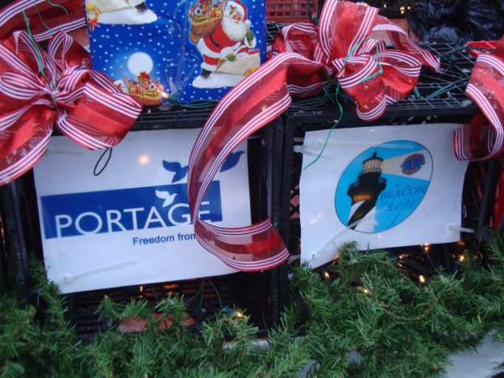
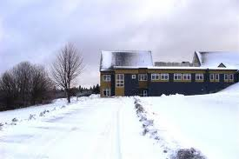
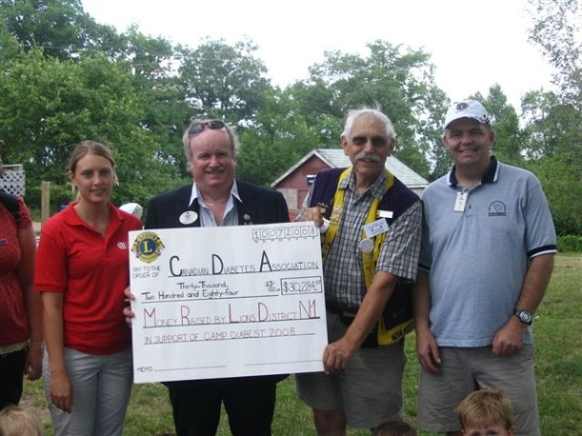
Your LIONS District N-1 Projects
Portage Christmas
Gifts for residents.
Cavalcade for Diabetes supporting research and the Canadian Diabetes Camp for children.
This years Cavalcade will be hosted by the:
Kensington Lions Club - June 1st in PEI
Newcastle Lions Club – June 15th in NB

Slide 51
District N-1 Organizational Chart
District Governor
1st Vice District Governor
Cabinet Secretary/Treasurer
2nd Vice District Governor
Immediate Past District Governor
Region Chair (optional)
Zone Chairperson (13)
Committee Chairpersons

Slide 52
Multiple District N
PURPOSE:
Further the Purposes of this Association

Slide 53
Multiple District N
PURPOSE:
Further the Purposes of this Association
Provide leadership, direction and initiative for International and Multiple District N programs and goals

Slide 54
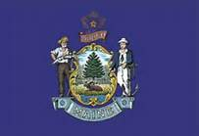
Multiple District N
PURPOSE:
Further the Purposes of this Association
Provide leadership, direction and initiative for International and Multiple District N programs and goals
Create and foster harmony between District Governors and District LIONS.
N-1
N-3
N-4
N-2

Slide 55
Multiple District N - Organizational Chart
Council of Governors
District N-1
District N-2
District N-3
District N-4
Council Chair
Council Secretary/Treasurer
Committee Chairpersons

Slide 56
Lions Clubs International
Organizational Chart
Lions
Board of Directors
International President
Immediate Past
International President
First Vice President
Second Vice President
Board Appointees

Slide 57
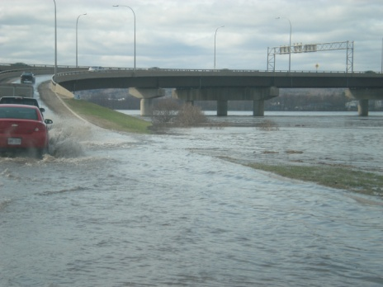
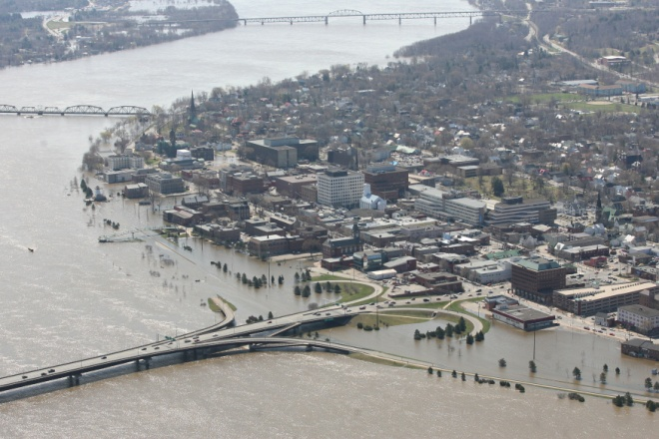
Lions Clubs International Foundation (LCIF)
Donations
Melvin Jones Fellowships
Progressive Melvin Jones Fellowships
LCIF assisted with the flood emergency of 2008 with a grant for $10,000.00.

Slide 58
Lions Foundation of Canada
Located is Oakville, ON, provides service dogs for six specialty areas:
Sight
Hearing
Special Needs
Seizure
Autism
Diabetes

Slide 59
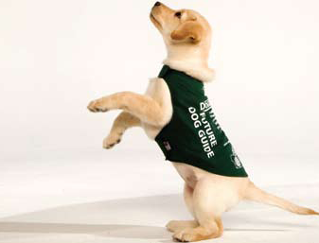
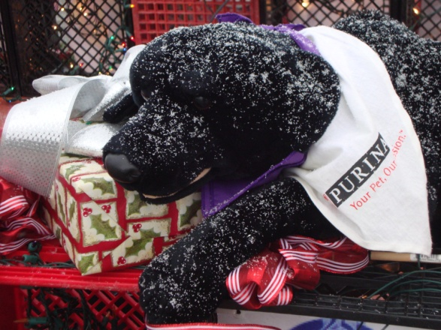
Lions Foundation of Canada
Ways to support the Foundation:
Life Membership in LFC
Progressive Life Membership in LFC
Judge Brian Stevenson Fellowship
Progressive Judge Brian Stevenson Fellowship
Memorial Forest Donation
Memorial Wall Donation
Buying LFC merchandise
Dog Walk
Notes:
Barkers Point Northside Lions - 100% Club

Slide 60
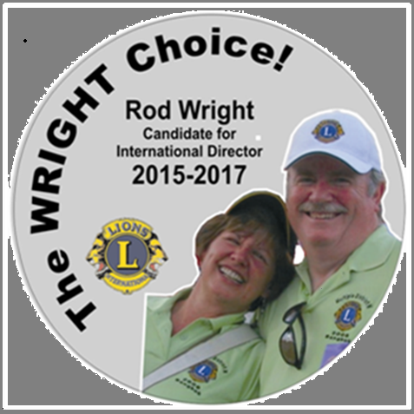
Thank you for attending and thank you for your continued support of my endorsement for international director. Please come to the MDN Convention in Moncton as every vote counts. Enjoy your convention.
The WRIGHT CHOICE – The WRIGHT Team
Notes:
Barkers Point Northside Lions - 100% Club

